Slide 1
CODING - DECODING

Slide 2
Coding Decoding
Coding-Decoding
Introduction
Concept of EJOTY
Different Coding patterns and how to identify them

Slide 3
Coding Decoding
INTRODUCTION TO CODING – DECODING
Coding
It is a process used to encrypt a word, a number in a particular code or pattern based on some set of rules. Hence Coding is the process of sending data from one person to another person in such a way that only the sender and receiver can understand the meaning without letting anyone else know the meaning of it.
Decoding
It is the reverse process of converting the coded information back into original form understandable by a receiver. Hence, decoding is the process of converting the coded data back into original form by applying the process of coding but in reverse process.
TYPES OF CODING
1. Letter coding
2. Number Coding
3. Substitution coding
4. Deciphering Coding
5. Coding by combinations of letters, Nos. and Symbols

Slide 4
Coding Decoding
SOME OF THE MAJOR TYPES OF CODING LOGIC
Constant addition in the position of letters.
2. Constant subtraction in the position of letters.
3. Denoting the position of letters in the whole alphabetical order.
4. Addition of the positions of all the letters to make code for the word.
5. Constant addition and subtraction alternatively in the position of all the letters.
6. Square of the number of letters in the word.
7. Arranging the letters in the alphabetical order.
8. Arrangement of letters in the word given in reverse order.
9. Interchanging each pair of the letters, in the given word.
10. Constant addition and then reversal of the letters to form the final word.

Slide 5
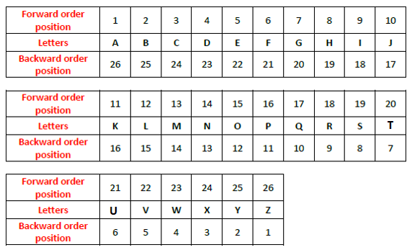
Coding Decoding

Slide 6
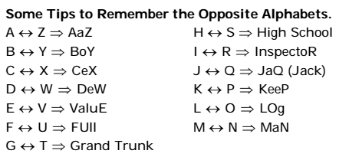
Coding Decoding

Slide 7
Coding Decoding
1. If FALSE is coded as EGZBKMRTDF, then the code for TRUTH will be
A. SURSTVSUGI
B. SUQSTVSUGI
C. SRQSTVSTGI
D. STQSTRSUGI
Notes:
Option B
Compulsory (Easy)

Slide 8
Coding Decoding
2. If ‘books' is called 'watch', 'watch' is called 'bag', 'bag' is called ‘window' and ‘window' is called 'dictionary', which is used to carry the books ?
A. watch
B. bag
C. dictionary
D. window
Notes:
Option D
Easy (Compulsory)

Slide 9
Coding Decoding
3. In a certain code language, ‘col min mot’ means ‘singing is appreciable’, ‘mot baj tip’ means ‘dancing is good’ and ‘min nop baj’ means ‘singing and dancing’, which of the following means ‘good’ in that code language?
A. min
B. baj
C. nop
D. tip
Notes:
Option D
Easy (Compulsory)

Slide 10
Coding Decoding
4. IF E = 5, PEN = 35, then PENCIL = ?
A. 57
B. 58
C. 59
D. 60
Notes:
Option C
Easy (Optional)

Slide 11
Coding Decoding
Directions(5-6): Study the following information carefully and answer the questions given below: In a certain code language,‘good time to buy’ is written as ‘mr bo nj kw’
‘devote money and time’ is written as ‘sy ta ge mr’.
‘buy good stuff only’ is written as ‘kw bo rd fp’.
‘only work and money’ is written as ‘ta fp sy ux’.
5. What is the code for “devote time to work” in the give code language?
A. ta ni re fp
B. ux ge nj sy
C. ge fp ux bo
D. ux ge nj mr
Notes:
Answer: D
Easy (Compulsory)

Slide 12
Coding Decoding
Directions(5-6): Study the following information carefully and answer the questions given below: In a certain code language,‘good time to buy’ is written as ‘mr bo nj kw’
‘devote money and time’ is written as ‘sy ta ge mr’.
‘buy good stuff only’ is written as ‘kw bo rd fp’.
‘only work and money’ is written as ‘ta fp sy ux’.
6. What is the code for “ buy time and money” in the given code language?
A. mr ta sy kw
B. bo nj ta ge
C. mr ta sy fp
D. kw nj kw bo
Notes:
Answer: A
Easy (Optional)

Slide 13
Coding Decoding
Directions(7-8): Study the following information carefully and answer the questions given beside
In a certain code language,
‘Become Your Role Model’ is written as ‘S4 C6 N5 Z4’ ‘Human Life World Change’ is written as ‘D6 I5 X5 M4’ ‘Insane Make Others Crazy’ is written as ‘D5 J6 N4 P6’
7. What is the code of the word ‘Revenue’ in the given code language?
A. R6
B. S6
C. P6
D. S7
Notes:
Option D
Moderate (Compulsory)

Slide 14
Coding Decoding
Directions(7-8): Study the following information carefully and answer the questions given beside
In a certain code language,
‘Become Your Role Model’ is written as ‘S4 C6 N5 Z4’ ‘Human Life World Change’ is written as ‘D6 I5 X5 M4’ ‘Insane Make Others Crazy’ is written as ‘D5 J6 N4 P6’
8. Which of the following words will have their code ‘S3’ in the given code language?
A. Ram
B. Rom
C. Ray
D. All these
Notes:
Option D
Moderate (Optional)

Slide 15
Coding Decoding
Directions(9-10): Study the following information carefully and answer the questions given beside:
In a certain code language,
‘Bank Account Money Deposit’ is written as ‘14#p 15@b 15$d 15$f’
‘Financial Institution Registered Always’ is written as ‘39%f 24#m 14%j 20&o’
‘Larger Interest Higher Amount’ is written as ‘15#j 23$o 36$n 25#b’
‘Reserved Credit Examine Daily’ is written as ‘9#s 9#b 23$f 13%y’
9. What is the code of the ‘Money and Time’?
A. 15#p 14@o 22#j
B. 14#p 14@o 22#k
C. 14#m 14@o 22#j
D. 14#p 14@o 22#j
Notes:
Answer: D
Expert (Compulsory)

Slide 16
Coding Decoding
Directions(9-10): Study the following information carefully and answer the questions given beside:
In a certain code language,
‘Bank Account Money Deposit’ is written as ‘14#p 15@b 15$d 15$f’
‘Financial Institution Registered Always’ is written as ‘39%f 24#m 14%j 20&o’
‘Larger Interest Higher Amount’ is written as ‘15#j 23$o 36$n 25#b’
‘Reserved Credit Examine Daily’ is written as ‘9#s 9#b 23$f 13%y’
10. ‘23#p 24#f’ is the code of which of the following?
A. Lower reward
B. Debit card
C. Credit card
D. Higher reward
Notes:
Answer: A
Expert (Optional)

Slide 17

Coding Decoding
Directions(11-12): In each of the following below is given a group of letters followed by four combinations of digits/symbols numbered (a), (b), (c) and (d). You have to find out which of the combinations correctly represents the group of letters based on the following coding system and mark the number of that combination as the answer. If none of the four combinations correctly represents the group of letters, mark (e), i.e. ‘None of these’ as the answer.
Note: If more than one condition applies then they are to be applied as per the order mentioned below.

Slide 18
Coding Decoding
Conditions:
(i) If the first letter is a vowel and the last letter is a consonant then both are coded with the code for the consonant.
(ii) If both 2nd letter and the last letter are vowels, then their codes are to be interchanged.
(iii) If 2nd letter is a consonant and 2nd last letter is a vowel, both are to be coded as the code for the vowel.
(iv) If both 1st letter and 5th letter are consonants then both are coded as the code for the third letter.
(v) If a given word does not follow any conditions mentioned above, then the code of the first letter is interchanged with code of the second letter and code of the third letter is interchanged with code of 4th letter and so on.

Slide 19
Coding Decoding
11. Find the code for “CRYKER”?
A. *9!$97
B. #9!$97
C. %9!$?7
D. !9%$97
Notes:
Answer: B
Expert (Compulsory)

Slide 20
Coding Decoding
12. Find the code for “ACTION”?
A. +44~4+
B. +4?~4+
C. +45~4+
D. +#4~4+
Notes:
Answer: C
Expert (Optional)

Slide 21
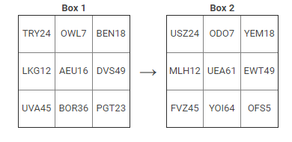
Coding Decoding
Directions(13-14): Read the following information carefully and answer the questions given beside.
The values in Box 1 are coded as the values at their respective position in Box 2 on the basis of following conditions.

Slide 22
Coding Decoding
Conditions:
If a grid:
Does not contain vowels:
i. If the number attached is a prime number then change the consonants to their immediate previous letter as per English alphabet series and change the number as per sum of its digit(until single digit is obtained).
ii. If the number attached is a composite number then change the consonants to their immediate next letter as per English alphabet series.
2. Does not contain consonants:
i. If the number attached is even then arrange the letters within the word as per reverse alphabetical order and interchange the digits of the number.
ii. If the number attached is odd then arrange the letters within the word as per alphabetical order.
3. Contains both vowels and consonants:
i. If the number is a perfect square then change the consonants to their reverse letters as per the English alphabet series and subtract the number from 100.
ii. If the number is not a perfect square then change the vowels to their reverse letters as per the English alphabet series.

Slide 23
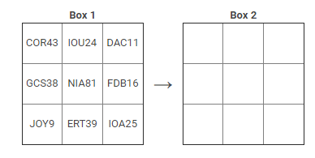
Coding Decoding
As per the given illustration and conditions find the values of Box 2 for the following.

Slide 24
Coding Decoding
13. What is the difference between the sum of odd numbers and the sum of even numbers of Box 2?
A. 104
B. 122
C. 129
D. None
Notes:
Answer-D
Expert (Compulsory)

Slide 25
Coding Decoding
14. Which letter does not come in box 2?
A. C
B. A
C. J
D. G
Notes:
Answer-C
Expert (Optional)

Slide 26

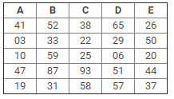
Coding Decoding
Directions(15-16): Read the following information carefully and answer the questions given beside.
The below mentioned table represents some words and their codes. The codes are assigned on the basis of some pattern.
Column A,B,C,D and E shows some numerical values which form the codes for the words asked. You have to mark the column name as your answer in which the code for the asked word lies. The words are to be coded in the same manner which is followed by the codes mentioned in the first table.
For example: If answer for the word STARE is asked then it would be ‘D’.

Slide 27
Coding Decoding
15. Identify the code for "DATE" belongs to which of the following?
A. A
B. C
C. E
D. B
Notes:
Answer: A
Expert (Compulsory)

Slide 28
Coding Decoding
16. The code for “MASSIVE" belongs to which of the following?
A. D
B. A
C. C
D. B
Notes:
Answer: C
Expert (Optional)

Slide 29
Directions
Directions
Main and Cardinal directions and angles between them
Distance and displacement between any two points
DS on based topic

Slide 30


There are four main directions - East, West, North and South as shown below:
Directions
There are four cardinal directions - North-East (N-E), North-West (N-W), South-East (S-E), and South-West (S-W) as shown below:

Slide 31
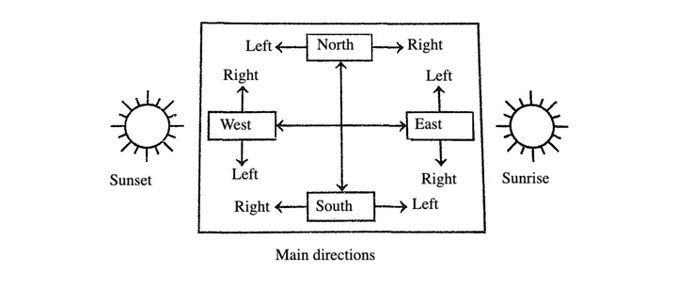
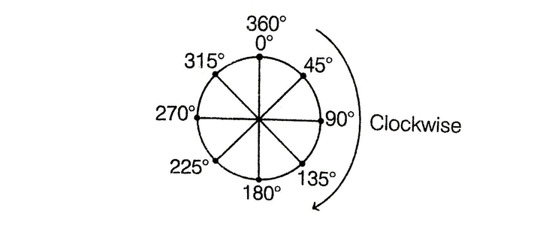
Directions
ANGLE OF MOVEMENT
For solving questions based on angle of movement, it is necessary to know the rotations which are given below
(i) Movement towards the right is called clockwise (CW) movement.

Slide 32
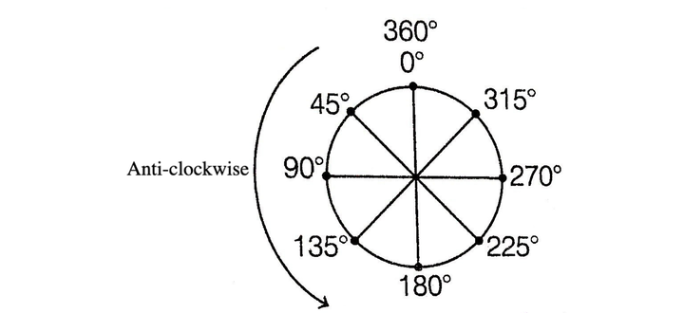
Directions
ANGLE OF MOVEMENT
(ii) Movement towards the left is called anti-clockwise (ACW) movement.

Slide 33
Directions
Concept of Shadow in presence of Sun:
At the time of sunrise if a man stands facing the east, his shadow will be towards west.
At the time of sunset the shadow of an object is always in the east.
If a man stands facing the North, at the time of sunrise his shadow will be towards his left and at the time of sunset it will be towards his right.
At 12:00 noon, the rays of the sun are vertically downward hence there will be no shadow.

Slide 34
Directions
17. S started walking towards east. After some time she turned to her left. Again after some time she turned to her right. After moving some distance she again turned to her right and began to move. At this time, in what direction was she moving?
a) South
b) North-West
c) North-East
d) East
Notes:
Correct Option: A
Easy (Compulsory)

Slide 35
Directions
18. R started walking towards west. After a while, he met his friend and both turned to their left. They halted for a while and started moving by turning again to their right. Finally R took a left turn at a corner. At which direction is R moving now?
a) South
b) West
c) North
d) East
Notes:
Correct Option: A
Easy (Compulsory)

Slide 36
Directions
19. If South-East becomes North and South becomes North-East and all the rest directions are changed in the same manner, the what will be the direction for West ?
a) North-East
b) North-West
c) South-East
d) South-West
Notes:
Correct Option: C
Easy (Optional)

Slide 37
Directions
20. S ran a distance of 40 m towards South. She then turned to the right and ran for about 15 m, turned right again and ran 50 m. Turning to right then ran for 15 m. Finally she turned to the left an angle of 135° and ran. In which direction was she running finally?
a) South-East
b) South-West
c) North-East
d) North-West
Notes:
Answer D
Moderate (Compulsory)

Slide 38
Directions
21. Vijay walks 10 m towards the North. From there he takes a U-Turn and walks 6 m. Then, he takes a left walks 3 m. What is the distance and direction of his current location with respect to his starting point?
(a) 4 km, South-West
(b) 5 km, South-West
(c) 5 km, South-East
(d) 5 km, North-East
Notes:
Answer D
Moderate (Compulsory)

Slide 39
Directions
22. A boy was misdirected from his way while returning to his home from his school. In order to reach his home, he first moved 3 km in North direction and then turned to his left and moved 2 km in straight direction on the road leading to the West. From there, he moved to his left and walked 3 km. After this, he again turned to his left and moved 1 km. Finally he reached his home. The home of the boy was in which direction from his school?
a) North
b) West
c) South
d) East
Notes:
Correct option: B
Moderate (Compulsory)

Slide 40
Directions
Directions (23 -24): Eight persons M through T are standing in such a way that O is 20 m apart from N towards West, N is 30 m South with respect to M. M is 40 m towards West with respect to Q. P is 50 m towards South with respect to Q. R is 15 m apart from S towards North. T is 20 m towards East with respect
to S. R is 40 m towards West with respect to P.
23. In which direction is R standing with respect to Q?
a) North-West
b) South-West
c) North-East
d) Cannot be determined
Notes:
Correct Option: B
Expert (Compulsory)

Slide 41
Directions
Directions (23-24): Eight persons M through T are standing in such a way that O is 20 m apart from N towards West, N is 30 m South with respect to M. M is 40 m towards West with respect to Q. P is 50 m towards South with respect to Q. R is 15 m apart from S towards North. T is 20 m towards East with respect to S. R is 40 m towards West with respect to P.
24. If one more person U is standing towards North-East with respect to P, then in which direction is T, standing with respect to U?
a) South-West
b) North-East
c) North-West
d) Cannot be determined
Notes:
Option A
Expert (Optional)

Slide 42
Directions
Directions Q (25-26): Nakul starts walking from his office towards his house. He starts from the front gate of his office and walks 5 km, then turns left and walks 2 km, then turns left again and walks 4 km, then he turns to his right and walks 3 km, then turns left and walks 1 km and then turns to his left again and walks 4 km, then turns to his right and walks 10 km and finally turns right and walks 3 km and thus reaches the front gate of his house.
25. If Nakul’s house is facing North, in which direction did he start walking?
a) East
b) West
c) South
d) North
Notes:
Option B
Moderate (Compulsory)

Slide 43
Directions
Directions Q (25-26): Nakul starts walking from his office towards his house. He starts from the front gate of his office and walks 5 km, then turns left and walks 2 km, then turns left again and walks 4 km, then he turns to his right and walks 3 km, then turns left and walks 1 km and then turns to his left again and walks 4 km, then turns to his right and walks 10 km and finally turns right and walks 3 km and thus reaches the front gate of his house.
26. Nakuls’s office is in which direction with respect to his house. If Nakul’s house is facing South?
a) South-West
b) South-East
c) North-West
d) Cannot be determined
Notes:
Option B
Moderate (Optional)

Slide 44
Directions
Directions (27-28): Study the information carefully and answer the questions given below.
A man walks 8m towards East to reach point P. He turns to his right and walks 5m to reach point Q. Then, he turns to his left and walks 9m to reach point R and he turns to his right and walks 11m to reach point S. Finally he turns to his right and walks 20m to reach point T.
27. What is the distance between starting point and R?
a) 13 m
b) 9 m
c) √314 m
d) 3√27 m
Notes:
Option C
Moderate (Optional)

Slide 45
Directions
Directions (27-28): Study the information carefully and answer the questions given below.
A man walks 8m towards East to reach point P. He turns to his right and walks 5m to reach point Q. Then, he turns to his left and walks 9m to reach point R and he turns to his right and walks 11m to reach point S. Finally he turns to his right and walks 20m to reach point T.
28. If a man walked 3m towards West from point T to reach point U, then what is the distance between point U and starting point?
a) 16 m
b) 3√27 m
c) 2√73 m
d) 33 m
Notes:
Option C
Moderate (Optional)

Slide 46
Directions
Directions Q. (29-30): Read the following information carefully and answer the questions given below it:
i. M?N means N is to the right of M at a distance of two metre.
ii. M*N means N is to the North of M at a distance of two metre.
iii. M+N means N is to the left of M at a distance of two metre.
iv. M%N means N is to the South of M at a distance of two metre.
v. In each of the following questions all persons face North.
29. If P % Q + R * S then P is in which direction with respect to S?
a) South-East
b) East
c) North
d) West
Notes:
Option B
Expert (Compulsory)

Slide 47
Directions
Directions Q. (29-30): Read the following information carefully and answer the questions given below it:
i. M?N means N is to the right of M at a distance of two metre.
ii. M*N means N is to the North of M at a distance of two metre.
iii. M+N means N is to the left of M at a distance of two metre.
iv. M%N means N is to the South of M at a distance of two metre.
v. In each of the following questions all persons face North.
30. If X ? R % Y ? Z then R is in which direction with respect to Z?
a) North- West
b) West
c) South-East
d) South-West
Notes:
Option A
Expert (Optional)

Slide 48
Coding Decoding
32. What is the code for ‘easy'? I. 'question is very difficult' is coded as '3 4 $ ©'. II. ‘easy question given below' is coded as ‘@ # 2 4'. III. 'very difficult is easy' is coded as '@ $ 4 3’ A. Only I and II B. Only II and III C. Only I and III D. All I, II and III E. None of these
Notes:
Option C
Easy (Compulsory)

Slide 49
Directions
34. Which village is to the North-East of village Amba?
Statement-1: Village Bambu is to the North of village Amba, villages Cira and Diqa are to the East and West of village Bambu respectively .
Statement-2: Village Puza is to the South of village Amba and village E is to the East of village Puza, village Kila is to the North of village Puza.
a) If the data in statement I alone are sufficient to answer the question, while the data in statement II alone are not sufficient to answer the question
b) If the data in statement II alone are sufficient to answer the question, while the data in statement I alone are not sufficient to answer the question
c) If the data either in statement I alone or in statement II alone are sufficient to answer the question
d) If the data given in both statements I and II together are not sufficient to answer the question and
e) If the data in both statements I and II together are necessary to answer the question.
Notes:
Option A
Moderate (Compulsory)

Slide 50
Any Doubts???

